Slide 2
NotiVal
A value based smart notification system

Slide 3
NotiVal
A value based smart notification system

Slide 8
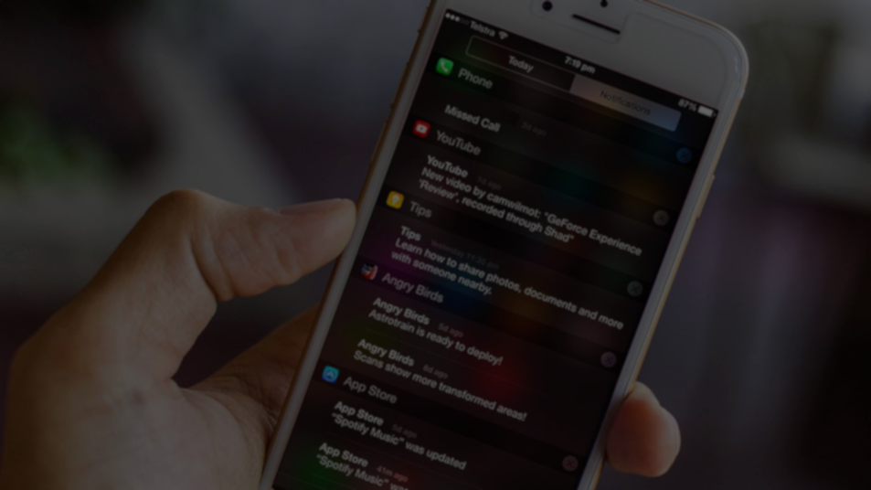
When to notify?

Slide 9
When to notify?

Slide 10
When to notify?

Slide 11
Watching TV – Promotes Happiness
Do work – Promotes Career
07:45
8:15
08:00
09:00
Brushing teeth – Promotes Health
Lock doors when leaving. – Promotes Safety

Slide 12
?

Slide 14

Introducing NotiVal

Slide 15
Introducing NotiVal

Slide 16
Introducing NotiVal
G
L
G
L
G
L
G
L
G
L
G
L
G
L

Slide 17
Introducing NotiVal
%
G
L
G
G
L
L
G
L
G
L
G
L
G
L
G
L

Slide 18


Slide 20
NotiVal
A value based smart notification system

